Slide 1

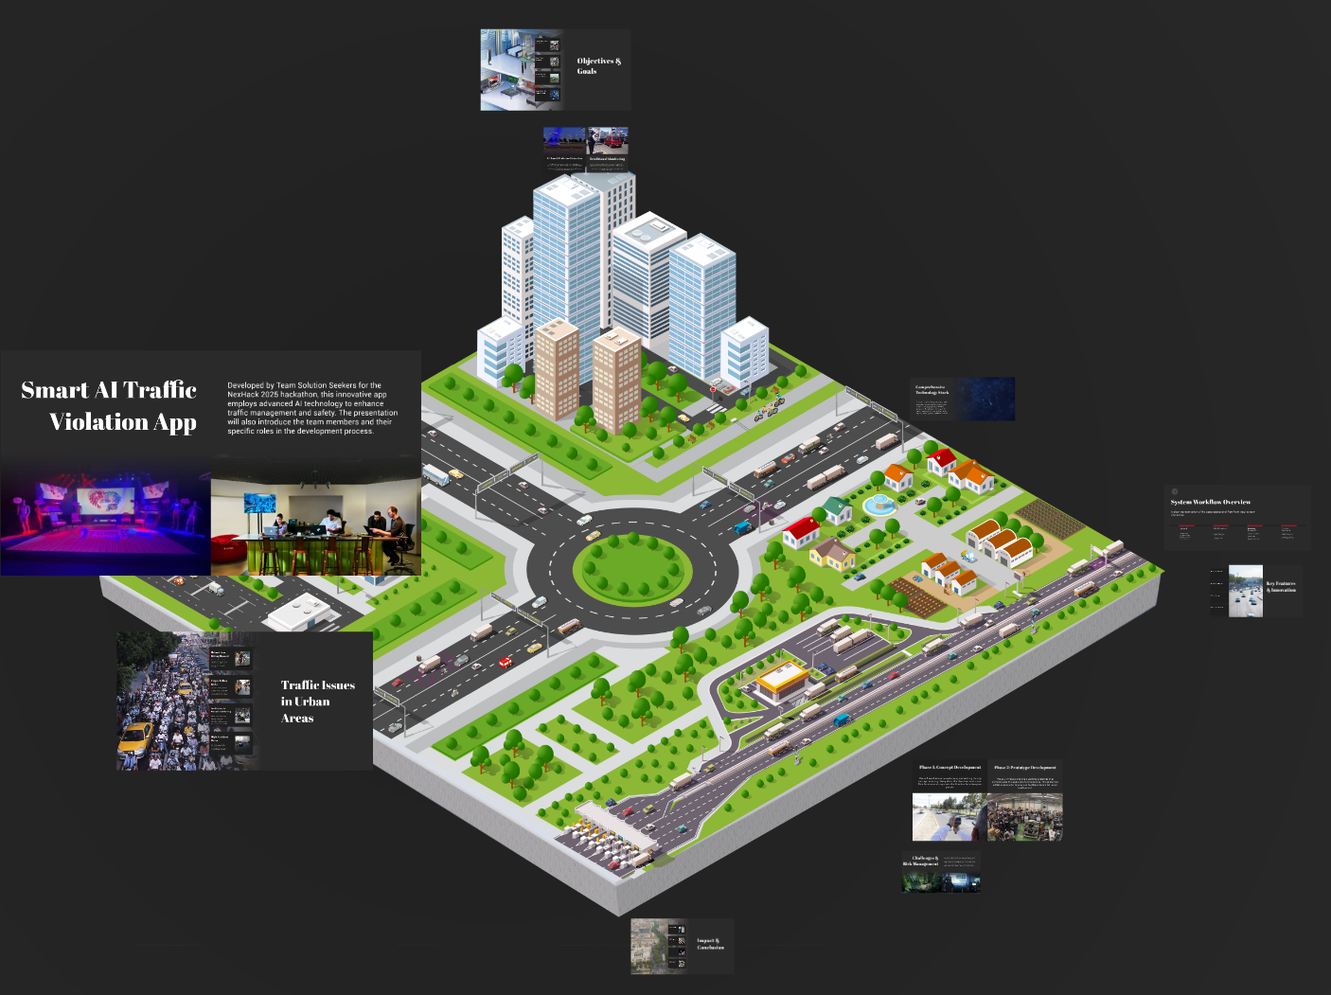
Smart AI Traffic Violation App
NexHack 2025
Team - Solution Seekers
Lead Developer: Amarjeet Yadav
AI Specialist: Arnav Thakur
Frontend Architect: Shoaib Akhtar
Backend Engineer: Deepanshu Singh
Notes:
1

Slide 2





Our Smart Solution: AI-Powered Enforcement
AI Detection
Utilising advanced AI, specifically YOLOv8, for accurate real-time violation identification.
Robust Backend
Powered by Flask for efficient data processing and seamless integration.
Secure Storage
Supabase ensures reliable, scalable, and secure storage of violation data.
Intuitive Dashboard
A responsive React frontend for monitoring, reporting, and management with a sleek dark UI.
Notes:
3

Slide 3
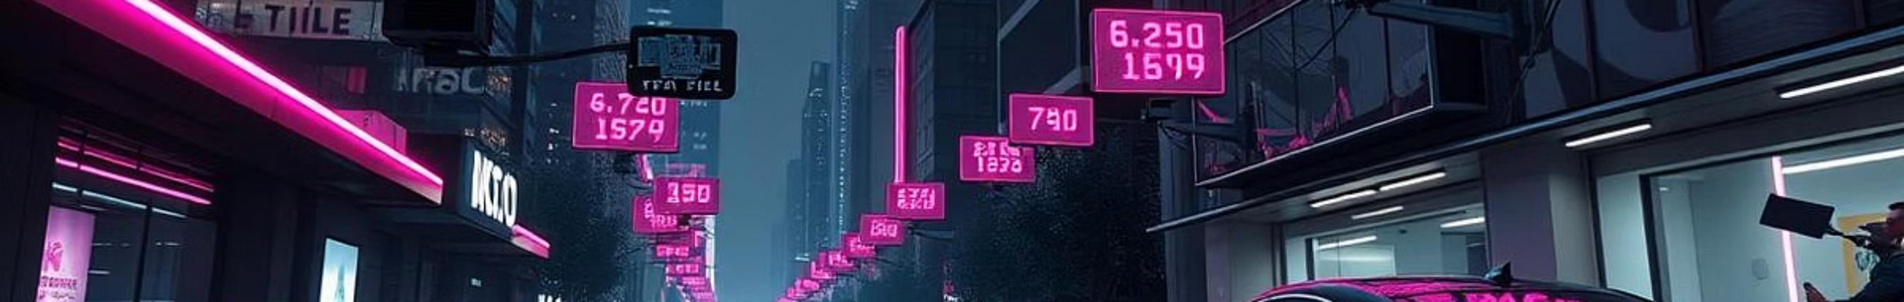




Objectives & Strategic Goals
Automated Detection
Real-time Results
Achieve highly accurate, automated identification of helmet-less and triple-riding violations.
Process video streams and flag violations instantly for immediate action.
Reduce Accidents
Scalable for Smart Cities
Contribute significantly to improved road safety and reduced accident rates by deterring violations.
Design a flexible architecture that can be deployed across multiple cities and integrated into smart city initiatives.
Notes:
4

Slide 4
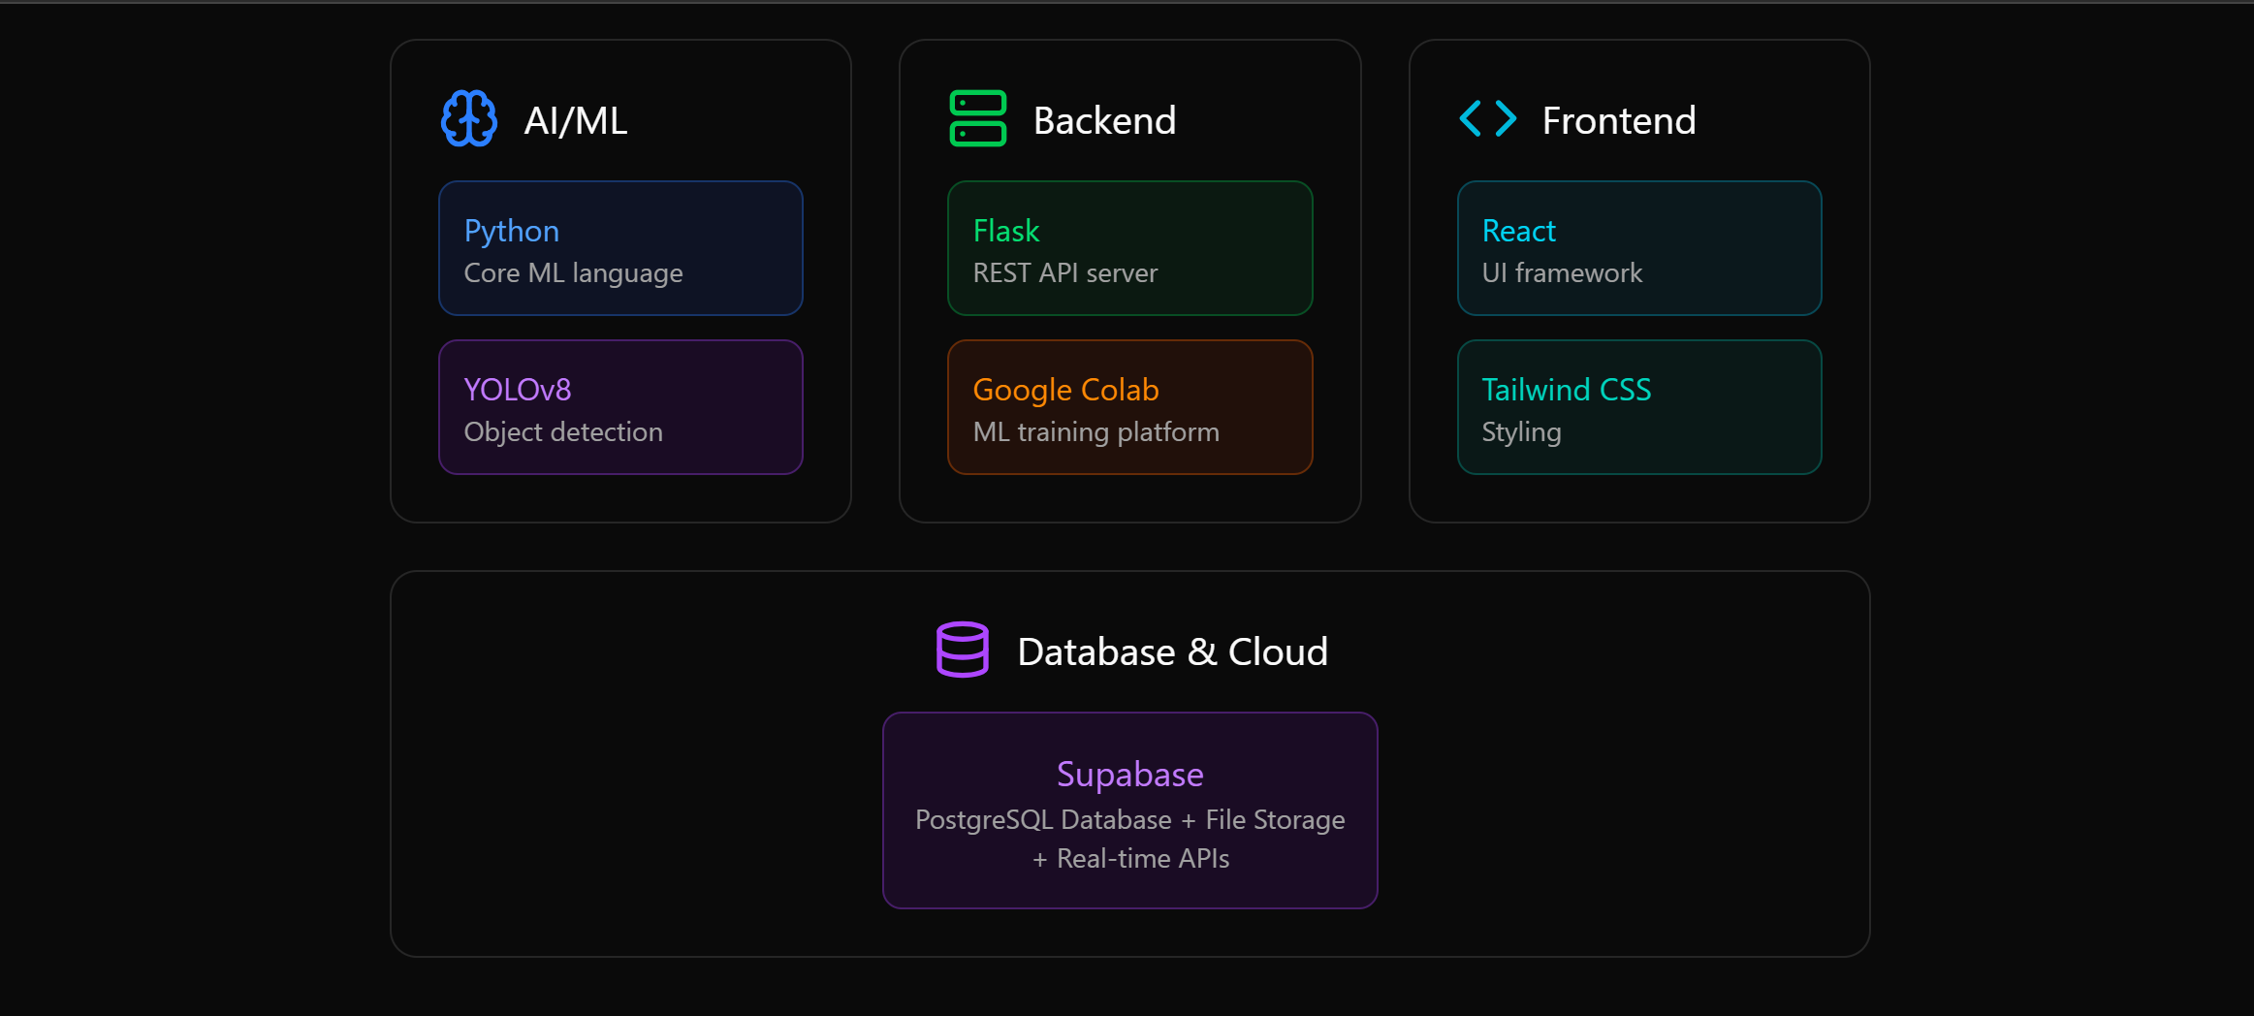







Our Robust Technology Stack
Python
Flask
React
Core language for AI model development and backend logic.
Lightweight web framework for efficient backend API services.
Frontend library for building a dynamic and intuitive user interface.
Tailwind CSS
YOLOv8
Supabase
Utility-first CSS framework for rapid and consistent styling.
State-of-the-art object detection model for real-time violation recognition.
Open-source alternative to Firebase for database, authentication, and storage.
Google Colab
Cloud-based platform for accelerated AI model training and experimentation.
Notes:
5

Slide 5

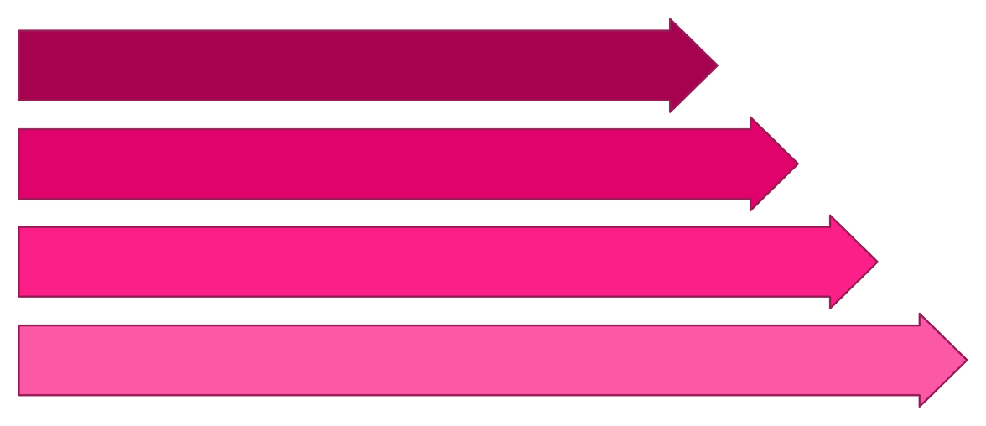
System Workflow: From Input to Insight
Video Upload
YOLO Detection
Supabase Storage
Frontend Dashboard
Our system processes traffic video feeds in a streamlined manner, from initial upload to AI detection, secure storage, and final presentation on the dashboard.
Notes:
6

Slide 6

Key Features & Innovation
Real-time Detection
Instant identification of violations as they occur, ensuring timely response.
Visual Marking
Violations are highlighted with red bounding boxes for clear identification and evidence.
Cloud Storage
Secure and scalable storage of violation footage and metadata on Supabase.
Dark UI Dashboard
An aesthetically pleasing and functional dashboard designed for optimal viewing in various lighting conditions, enhancing user experience.
Notes:
7

Slide 7

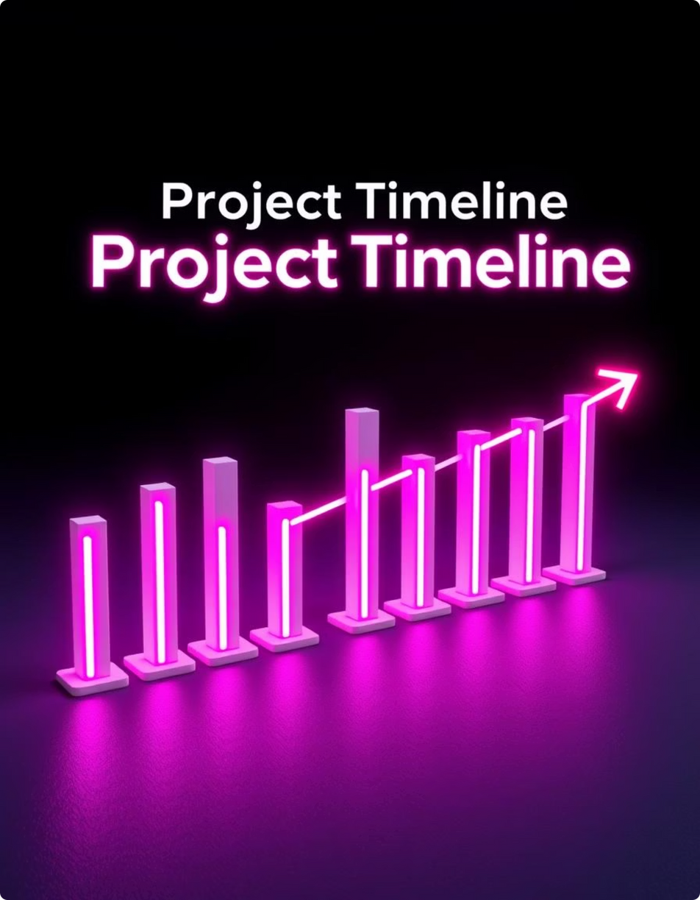
Implementation Plan: Our Road Ahead
Phase 1: Idea & Research
Conceptualisation, feasibility study, and initial technology stack selection.
Phase 2: Prototype Development
Building core functionalities: basic YOLO integration, Flask backend, and React frontend skeleton.
Phase 3: Dataset Training & Testing
Curating and augmenting datasets, training YOLOv8, rigorous testing, and fine-tuning.
Phase 4: Cloud Deployment
Optimisation for performance, deployment on cloud infrastructure, and final security audits.
Notes:
8

Slide 8




Challenges & Risk Management
Dataset Quality
Scaling Issues
Risk: Insufficiently diverse or labelled data leading to poor model performance.Mitigation: Continuous data augmentation and manual annotation by experts; leveraging public datasets.
Risk: Performance degradation under high traffic loads in multiple cities.Mitigation: Optimised cloud infrastructure (GPU acceleration), load balancing, and efficient database indexing.
False Detections
Data Security
Risk: Misidentification of violations, leading to incorrect penalties.Mitigation: Iterative model retraining with edge cases, post-detection human verification for critical incidents.
Risk: Unauthorised access or data breaches of sensitive violation information.Mitigation: End-to-end encryption, regular security audits, and adherence to data protection regulations.
Notes:
9

Slide 9
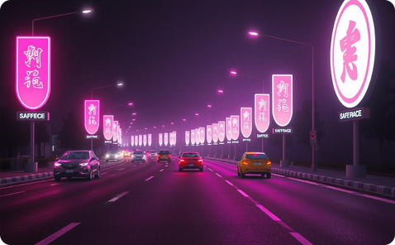



Transformative Impact & Conclusion
Safer Roads
Reduced Manual Work
Support for Digital India
Scalable & Adaptive
A significant reduction in traffic violations leading to fewer accidents and increased public safety.
Automating violation detection frees up law enforcement resources for more critical tasks.
A flexible solution ready for deployment across diverse urban environments, contributing to a smarter future.
A crucial step towards smart city infrastructure and digitally empowered governance.
Join Team Solution Seekers in Paving the Way for Smarter, Safer Cities!
Notes:
10

